Slide 1
Exercise: Check Rotation
Problem
Given two strings s1 and s2, can we find s2 as a substring in a rotation (circular shift) of s1?
For example
Return true when given s1=AABCD and s2=CDAA
Return false when given s1=ABCD and s2=ACBD

Slide 2
Exercise: Check Rotation
char src[] = “AABBCD”;
char des[] = “CDAA”;
int len = strlen(src);
for (int i = 0; i < len; ++i) {
char tempchar = src[0];
for (int j = 0; j < len-1; ++j)
src[j] = src[j+1];
src[len-1] = tempchar;
if (strstr(src,des)!=NULL)
return(true);
}
return false;

Slide 3
Exercise: Check Rotation
char src[] = “AABBCD”;
char des[] = “CDAA”;
int len = strlen(src);
char* tempstr = new char[2*len];
strcpy(tempstr, src);
strcpy(tempstr+len, src, len-1);
if (strlen(des) > len)
return false;
else
return (strstr(tempstr, des)!=NULL);

Slide 4
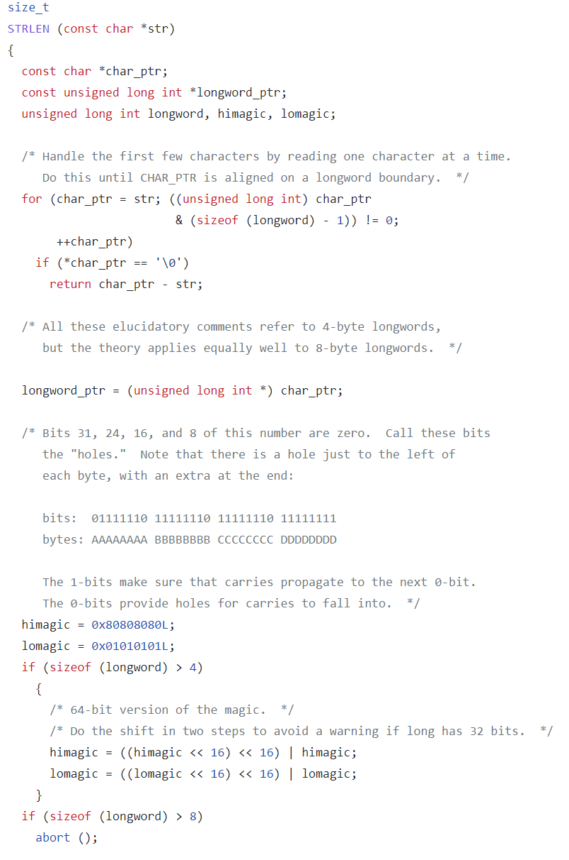
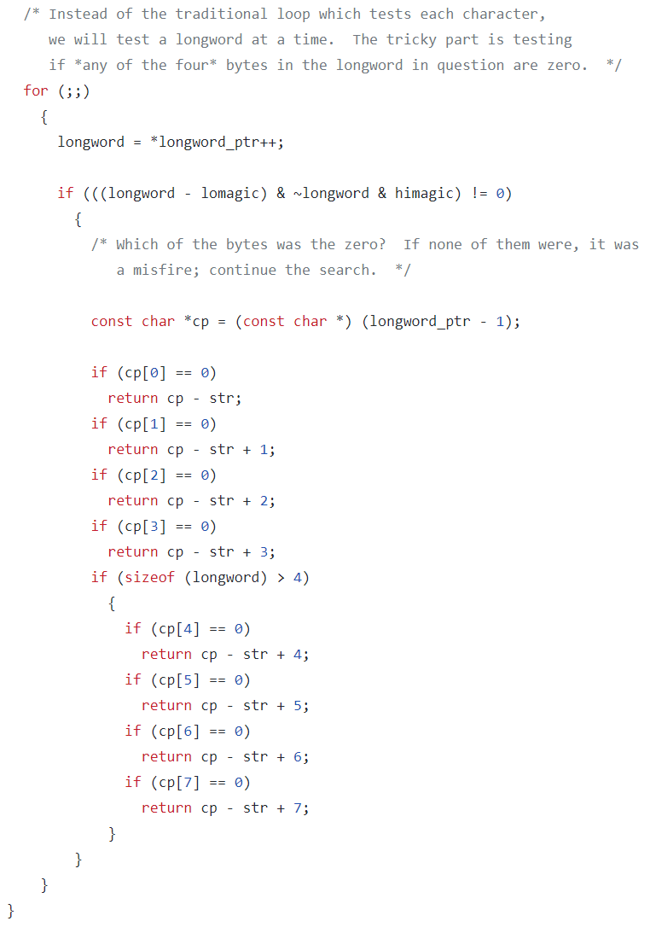
strlen() in glibc 2.24
https://github.com/lattera/glibc/blob/master/string/strlen.c

Slide 5
Complexity of strstr()
in glibc before 2008
O(nm) worst-case runtime, O(log m) extra space
where n = strlen(str1), m = strlen(str2)
in glibc after 2008: two-way algorithm, published in 1991
O(n) worst case runtime, O(1) extra space
(3n–m) comparisons in the worst case
Short pattern (<32)
initialization: 2m comparisons
Long pattern (>=32)
initialization: (3m + 2^8) operations
https://en.wikipedia.org/wiki/Two-way_string-matching_algorithm
Notes:
glibc/string/str-two-way.h
glibc/sysdeps/x86/bits/string.h

Slide 6
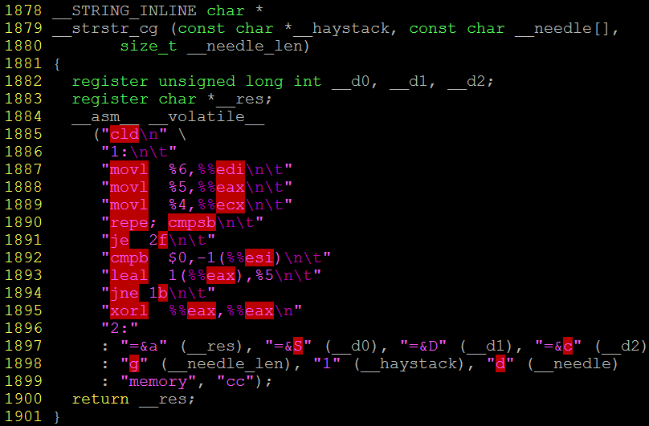
Complexity of strstr()
Architecture-dependent implementation seems O(mn) but is faster in practice…

Slide 7
Two-way Algorithm: Period Function
Input: Target S, Pattern P
For any string, Period(x)
Minimum p such that
for any integer 0 < i ≤ |x| − p, x[i] = x[i + p]
"p is a period of x if two letters of x at distance p always coincide"
Example
Period(“ababadada”) = 8

Slide 8
Two-way Algorithm: Maximal Suffix
Consider string P
Let P=uv where v=MaxSuf(P)
The maximal suffix is defined as: if u is non-empty, then no suffix of u will be equal to a prefix of v
Also say: P=uv is a maximal suffix factoriazation of P
Example
P = ababadada
P = uv = ababa.dada
No suffix of ababa is equal to a prefix of dada

Slide 9
Two-way Algorithm: Short Maximal Suffix
If a maximal suffix of a string x satisfies
|MaxSuf(x)| <= |x| / 2
We say that this maximal suffix is a short maximal suffix of x
Example
P = ababadada
P = uv = ababa.dada
dada is a short maximal suffix

Slide 10
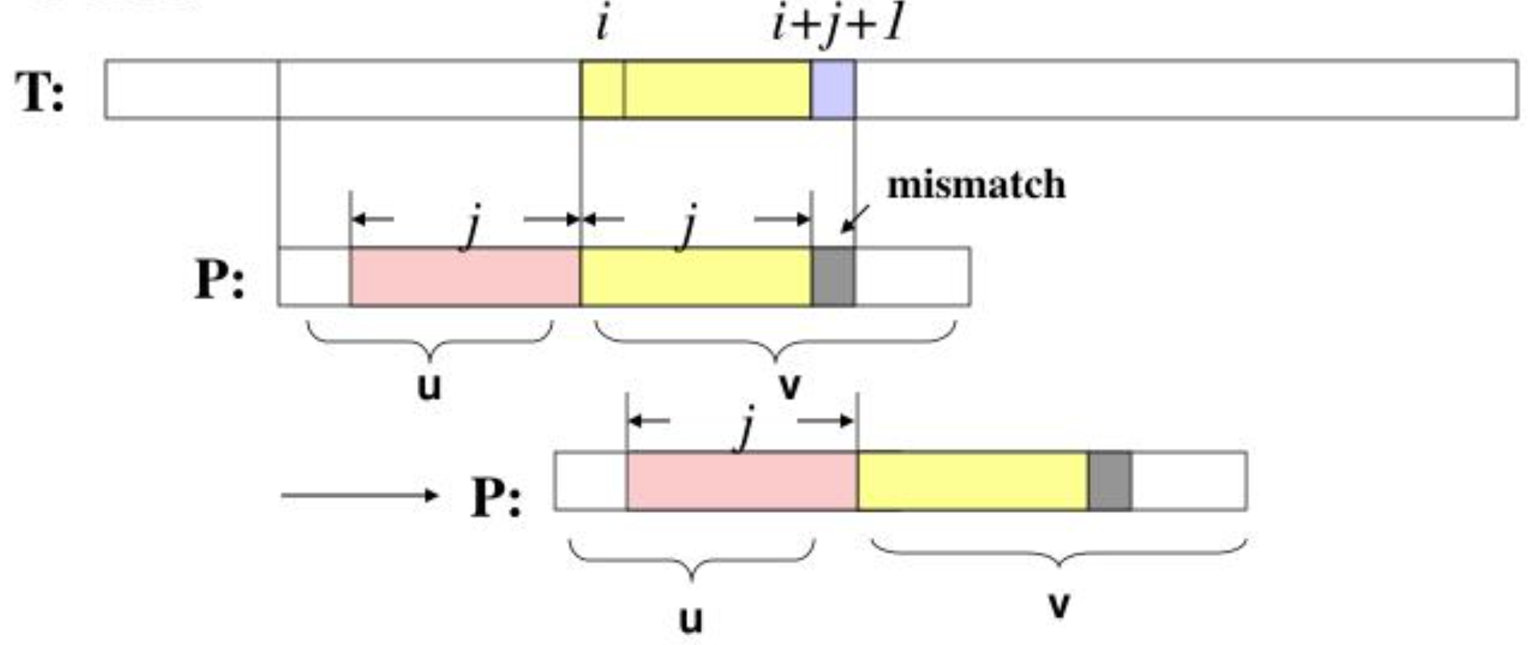
Two-way Algorithm: Key idea
Let P=uv, v is a short maximal suffix
If match failures occurs at (j+1)-th character in v, we can shift P by (j+1) positions safely

Slide 11
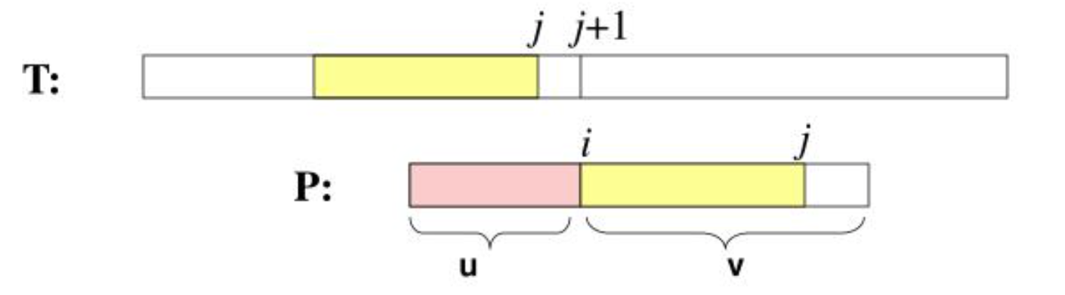
Two-way Algorithm: Key idea
Short v is important !!!
May equal!

Slide 12
Two-way Algorithm: Procedure
Assume short maximal suffix exists
Calculate factorization P = uv, v is a short maximal suffix
Matching v from left to right (prefix first matching)
If mismatch occurs at (j+1)-th character in v, shift P by (j+1) positions and then restart matching v from left to right
If v is matched, try to match u from right to left (suffix first matching)
If mismatch occurs, shift P by Period(P)

Slide 13
Full example
P = uv = ABCD.ABD
i: | 0 | 1 | 2 | 3 | 4 | 5 | 6 | 7 | 8 | 9 | 10 | 11 | 12 | 13 | 14 | 15 | 16 | 17 | 18 | 19 | 20 | 21 | 22
S: | A | B | C |  | A | B | C | D | A | B |  | A | B | C | D | A | B | C | D | A | B | D | E
P: | A | B | C | D | A | B | D
j: | 0 | 1 | 2 | 3 | 4 | 5 | 6
Try matching v -> shift by 3

Slide 14
Full example
P = uv = ABCD.ABD
i: | 0 | 1 | 2 | 3 | 4 | 5 | 6 | 7 | 8 | 9 | 10 | 11 | 12 | 13 | 14 | 15 | 16 | 17 | 18 | 19 | 20 | 21 | 22
S: | A | B | C |  | A | B | C | D | A | B |  | A | B | C | D | A | B | C | D | A | B | D | E
P: |  |  |  | A | B | C | D | A | B | D
j: |  |  |  | 0 | 1 | 2 | 3 | 4 | 5 | 6
Try matching v -> shift by 1

Slide 15
Full example
P = uv = ABCD.ABD
i: | 0 | 1 | 2 | 3 | 4 | 5 | 6 | 7 | 8 | 9 | 10 | 11 | 12 | 13 | 14 | 15 | 16 | 17 | 18 | 19 | 20 | 21 | 22
S: | A | B | C |  | A | B | C | D | A | B |  | A | B | C | D | A | B | C | D | A | B | D | E
P: |  |  |  |  | A | B | C | D | A | B | D
j: |  |  |  |  | 0 | 1 | 2 | 3 | 4 | 5 | 6
Try matching v -> shift by 3

Slide 16
Full example
P = uv = ABCD.ABD
i: | 0 | 1 | 2 | 3 | 4 | 5 | 6 | 7 | 8 | 9 | 10 | 11 | 12 | 13 | 14 | 15 | 16 | 17 | 18 | 19 | 20 | 21 | 22
S: | A | B | C |  | A | B | C | D | A | B |  | A | B | C | D | A | B | C | D | A | B | D | E
P: |  |  |  |  |  |  |  | A | B | C | D | A | B | D
j: |  |  |  |  |  |  |  | 0 | 1 | 2 | 3 | 4 | 5 | 6
Try matching v -> shift by 3

Slide 17
Full example
P = uv = ABCD.ABD
i: | 0 | 1 | 2 | 3 | 4 | 5 | 6 | 7 | 8 | 9 | 10 | 11 | 12 | 13 | 14 | 15 | 16 | 17 | 18 | 19 | 20 | 21 | 22
S: | A | B | C |  | A | B | C | D | A | B |  | A | B | C | D | A | B | C | D | A | B | D | E
P: |  |  |  |  |  |  |  |  |  |  | A | B | C | D | A | B | D
j: |  |  |  |  |  |  |  |  |  |  | 0 | 1 | 2 | 3 | 4 | 5 | 6
Try matching v -> shift by 1

Slide 18
Full example
P = uv = ABCD.ABD
i: | 0 | 1 | 2 | 3 | 4 | 5 | 6 | 7 | 8 | 9 | 10 | 11 | 12 | 13 | 14 | 15 | 16 | 17 | 18 | 19 | 20 | 21 | 22
S: | A | B | C |  | A | B | C | D | A | B |  | A | B | C | D | A | B | C | D | A | B | D | E
P: |  |  |  |  |  |  |  |  |  |  |  | A | B | C | D | A | B | D
j: |  |  |  |  |  |  |  |  |  |  |  | 0 | 1 | 2 | 3 | 4 | 5 | 6
Try matching v -> shift by 3

Slide 19
Full example
P = uv = ABCD.ABD
i: | 0 | 1 | 2 | 3 | 4 | 5 | 6 | 7 | 8 | 9 | 10 | 11 | 12 | 13 | 14 | 15 | 16 | 17 | 18 | 19 | 20 | 21 | 22
S: | A | B | C |  | A | B | C | D | A | B |  | A | B | C | D | A | B | C | D | A | B | D | E
P: |  |  |  |  |  |  |  |  |  |  |  |  |  |  | A | B | C | D | A | B | D
j: |  |  |  |  |  |  |  |  |  |  |  |  |  |  | 0 | 1 | 2 | 3 | 4 | 5 | 6
Try matching v -> shift by 1

Slide 20
Full example
P = uv = ABCD.ABD
i: | 0 | 1 | 2 | 3 | 4 | 5 | 6 | 7 | 8 | 9 | 10 | 11 | 12 | 13 | 14 | 15 | 16 | 17 | 18 | 19 | 20 | 21 | 22
S: | A | B | C |  | A | B | C | D | A | B |  | A | B | C | D | A | B | C | D | A | B | D | E
P: |  |  |  |  |  |  |  |  |  |  |  |  |  |  |  | A | B | C | D | A | B | D
j: |  |  |  |  |  |  |  |  |  |  |  |  |  |  |  | 0 | 1 | 2 | 3 | 4 | 5 | 6
v matched!
Try matching u
Successful!

Slide 21
Another example
P = uv = ababa.dada
i: | 0 | 1 | 2 | 3 | 4 | 5 | 6 | 7 | 8 | 9 | 10 | 11 | 12 | 13 | 14 | 15 | 16 | 17 | 18 | 19 | 20 | 21 | 22
S: | a | d | a | d | a | d | a | d | d | a | d | a | d | a | b | a | b | a | d | a | d | a | c
P: | a | b | a | b | a | d | a | d | a
j: | 0 | 1 | 2 | 3 | 4 | 5 | 6 | 7 | 8
Try v -> shift by 4

Slide 22
Another example
P = uv = ababa.dada
i: | 0 | 1 | 2 | 3 | 4 | 5 | 6 | 7 | 8 | 9 | 10 | 11 | 12 | 13 | 14 | 15 | 16 | 17 | 18 | 19 | 20 | 21 | 22
S: | a | d | a | d | a | d | a | d | d | a | d | a | d | a | b | a | b | a | d | a | d | a | c
P: |  |  |  |  | a | b | a | b | a | d | a | d | a
j: |  |  |  |  | 0 | 1 | 2 | 3 | 4 | 5 | 6 | 7 | 8
Try v -> shift by 1

Slide 23
Another example
P = uv = ababa.dada
i: | 0 | 1 | 2 | 3 | 4 | 5 | 6 | 7 | 8 | 9 | 10 | 11 | 12 | 13 | 14 | 15 | 16 | 17 | 18 | 19 | 20 | 21 | 22
S: | a | d | a | d | a | d | a | d | d | a | d | a | d | a | b | a | b | a | d | a | d | a | c
P: |  |  |  |  |  | a | b | a | b | a | d | a | d | a
j: |  |  |  |  |  | 0 | 1 | 2 | 3 | 4 | 5 | 6 | 7 | 8
v matched
Try u -> shift by Period(P) = 8

Slide 24
Another example
P = uv = ababa.dada
i: | 0 | 1 | 2 | 3 | 4 | 5 | 6 | 7 | 8 | 9 | 10 | 11 | 12 | 13 | 14 | 15 | 16 | 17 | 18 | 19 | 20 | 21 | 22
S: | a | d | a | d | a | d | a | d | d | a | d | a | d | a | b | a | b | a | d | a | d | a | c
P: |  |  |  |  |  |  |  |  |  |  |  |  |  | a | b | a | b | a | d | a | d | a
j: |  |  |  |  |  |  |  |  |  |  |  |  |  | 0 | 1 | 2 | 3 | 4 | 5 | 6 | 7 | 8
Match v first, then u -> successful!

Slide 25
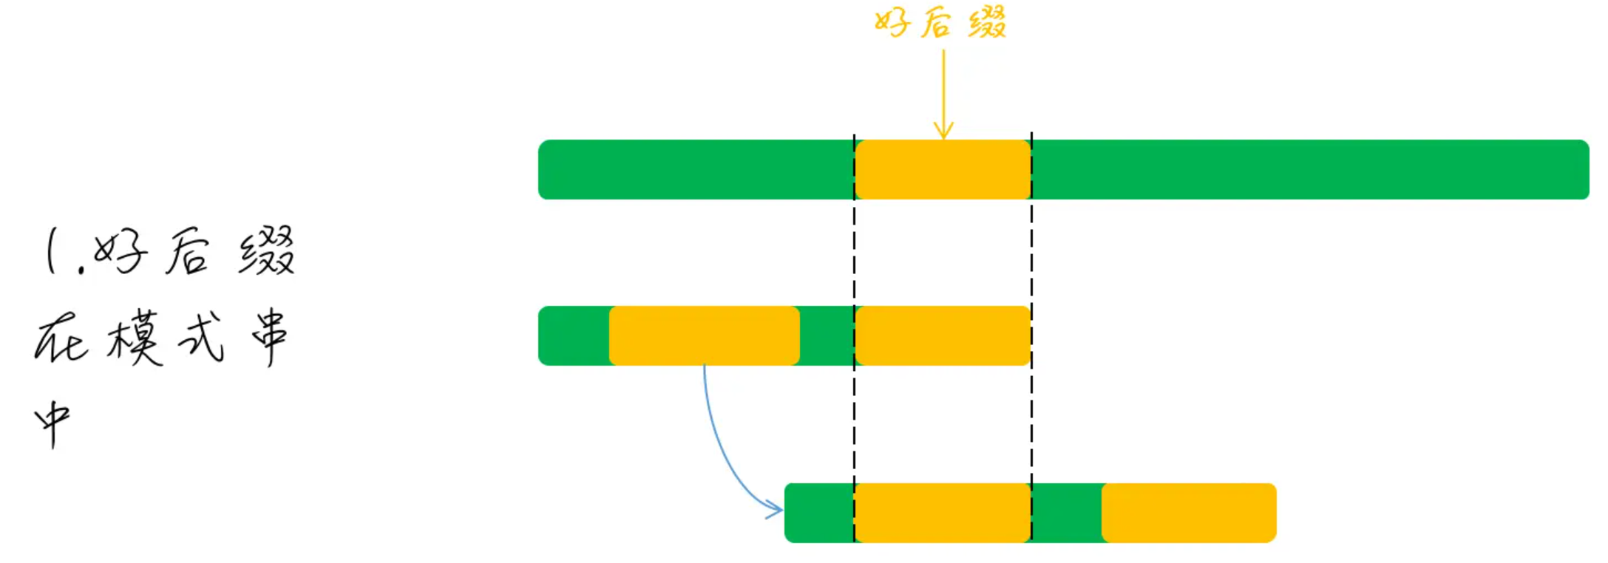
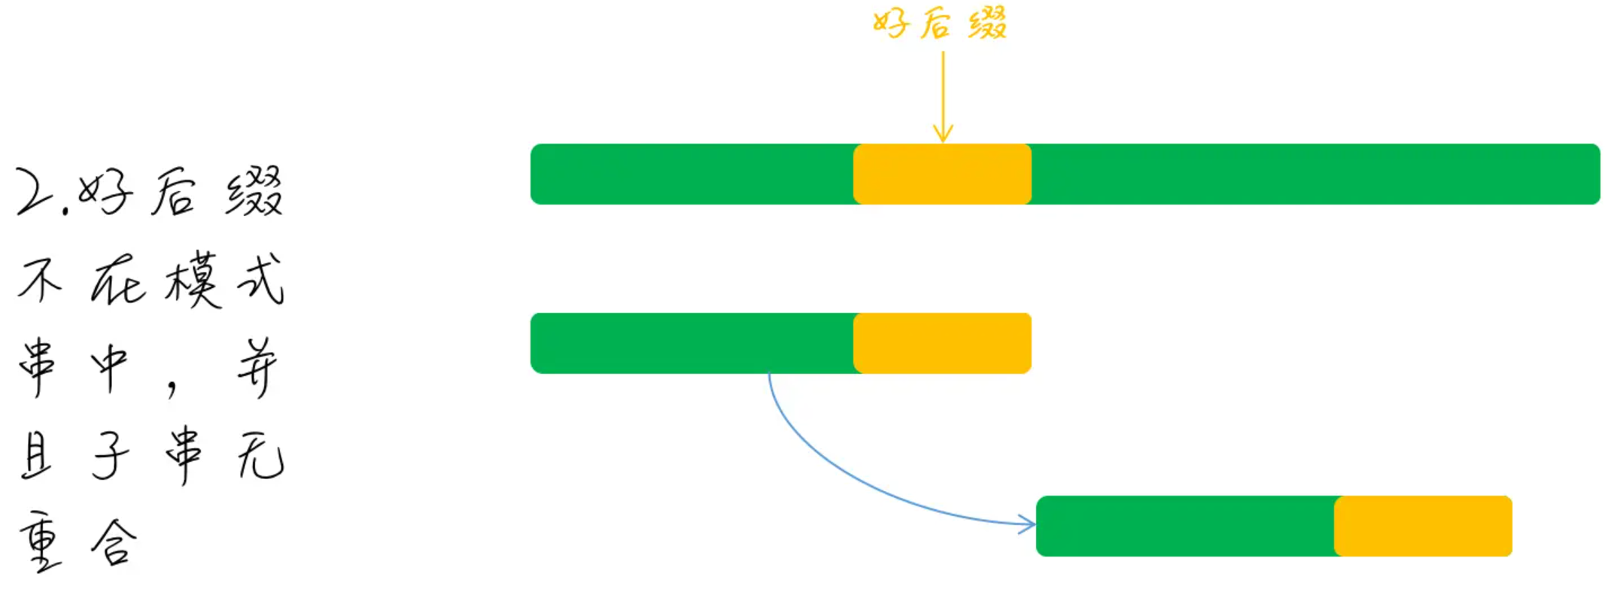
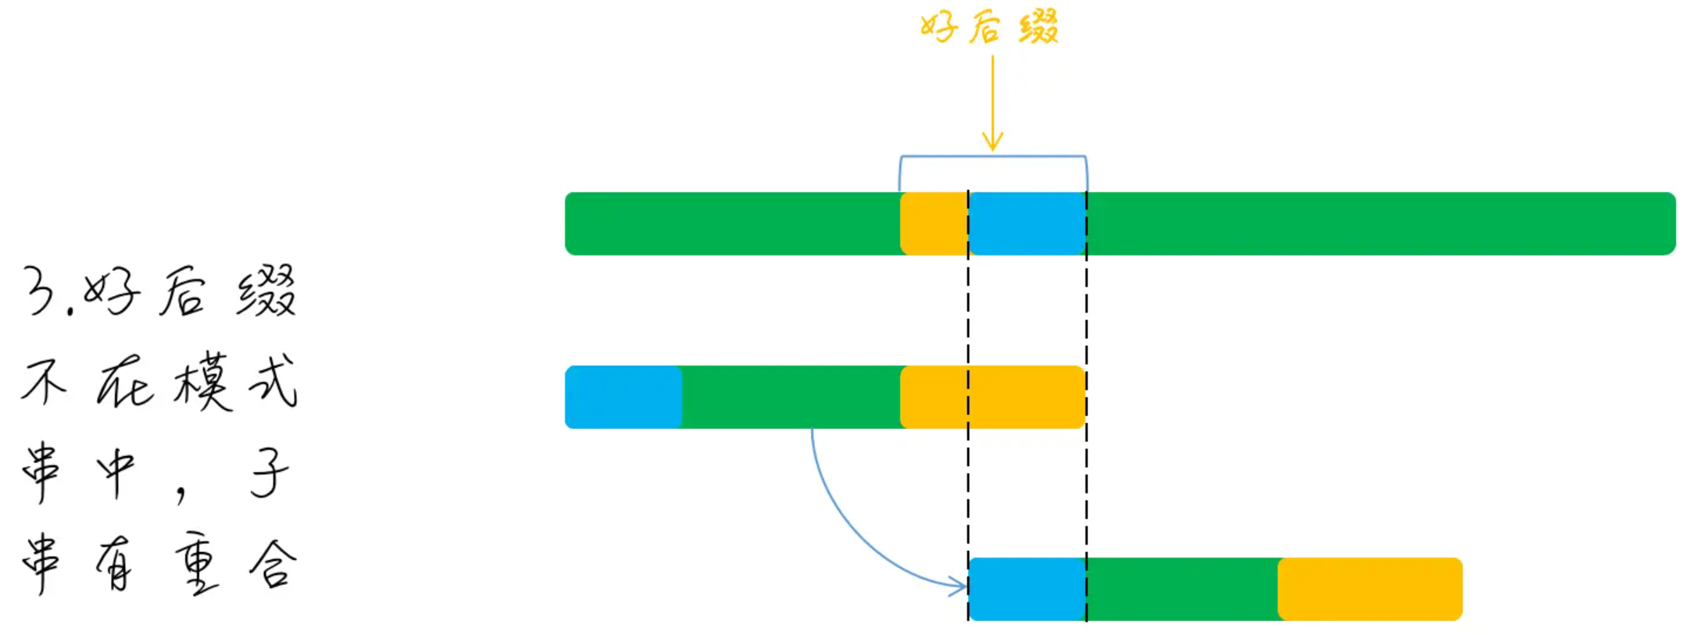
Why Period(P) When Matching u?
Similar to “Good suffix” in BM Algorithm

Slide 26
If no short maximal suffix?
Simple reverse P and T

Slide 27
Actual Two-Way Algorithm
A clever algorithm to calculate maximal suffix and period of maximal suffix at the same time
O(n) time to calculate
O(log m) space
O(n) time to match

Slide 28
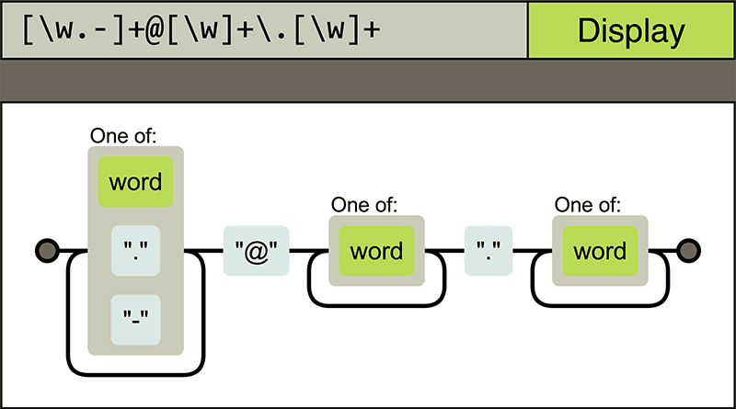
Relation between Pattern Matching and DFA
Deterministic Finite Automaton (DFA)
Reference course
04830150 Compiler Design (编译技术)

Slide 29
Pattern Matching using DFA
Assume P = nano
Assume S is given as a stream
How much memory do we need for pattern matching?
S | = | … | b | a | n | a | n | a | n | o | b | a | n | o | …
= ?
n | a | n | o

Slide 30
DFA
Alphabet: Σ = {a, n, o, …}
States: Q = {empty, n, na, nan, nano}
Initial state: empty; final state: nano
State transition function
δ: Q×Σ→Q (represented by arrows below)

Slide 31
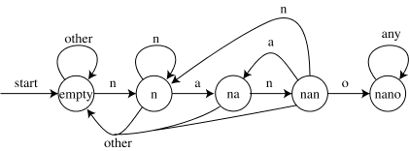
DFA
Alphabet: Σ = {a, n, o, …}
States: Q = {empty, n, na, nan, nano}
Initial state: empty; final state: nano
State transition function
δ: Q×Σ→Q (represented by arrows below)

Slide 32
DFA
How to build a state-transition function?
Given pattern P[0..m-1]
we have (1+m) states Q = {0, 1, …, m}
where 0 is the initial state, and m is the final state
Define a suffix function σ(x)
σ(x) is the length of the longest suffix of x that matches a prefix of P with the same length
For example, P=ab, σ(ε)=0, σ(ccaca)=1, σ(ccab)=2
Define δ(q,c) = σ(P[1..q]+c) where + is concatenation

Slide 33
Pattern Matching using DFA
Naïve algorithm to build an DFA
Character set Σ
Pattern length m; thus |Q| = m+1
O(|Σ| m) space to store the transition table
O(|Σ| m²) time to build the transition table
Complexity of pattern matching
O(n) where n = s.length()

Slide 34
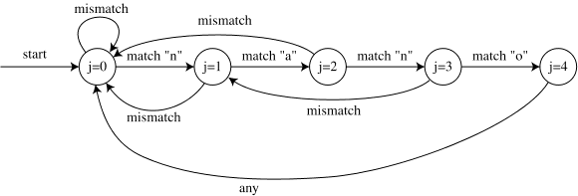
DFA for KMP Algorithm
Compression of the transition table
Space O(|Σ| m) is reduced to O(m)
#transitions per state: O(|Σ|) => O(2) (match/mismatch)
Efficient algorithm to build the table
Time O(|Σ| m²) is reduced to O(m)
using a dynamic-programming style algorithm
O(n) time to scan the target string

Slide 35
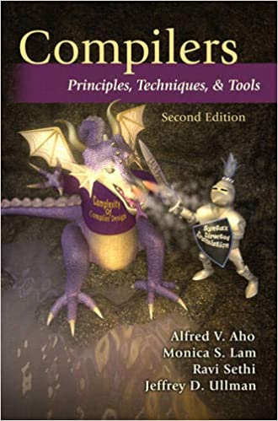

New Problem: Matching Multiple Patterns
Inefficient if we match each pattern one by one
Aho-Corasick (AC) Algorithm
Proposed in Bell Lab in 1975
Key idea
Construct a single DFA for the multiple patterns
Alfred Aho (Turing Award 2020)
http://cr.yp.to/bib/1975/aho.pdf

Slide 36
AC Algorithm
3 types of functions for DFA
g(pre, x) = next: goto function
In state pre, character x -> goto state next
output(s): output function
In state s -> a corresponding pattern is match!
f(current) = next: failure function
If match fails in state current, move to state next

Slide 37
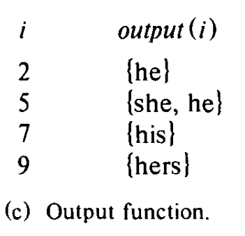
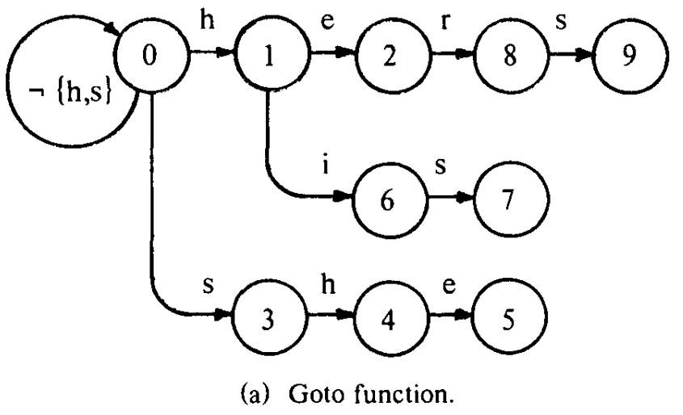
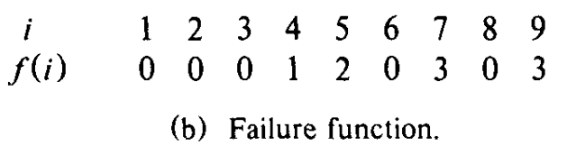
AC Algorithm: Example
Consider four patterns
{he, she, his, hers}

Slide 38
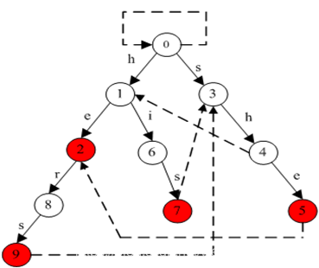
AC Algorithm: Example

Slide 39
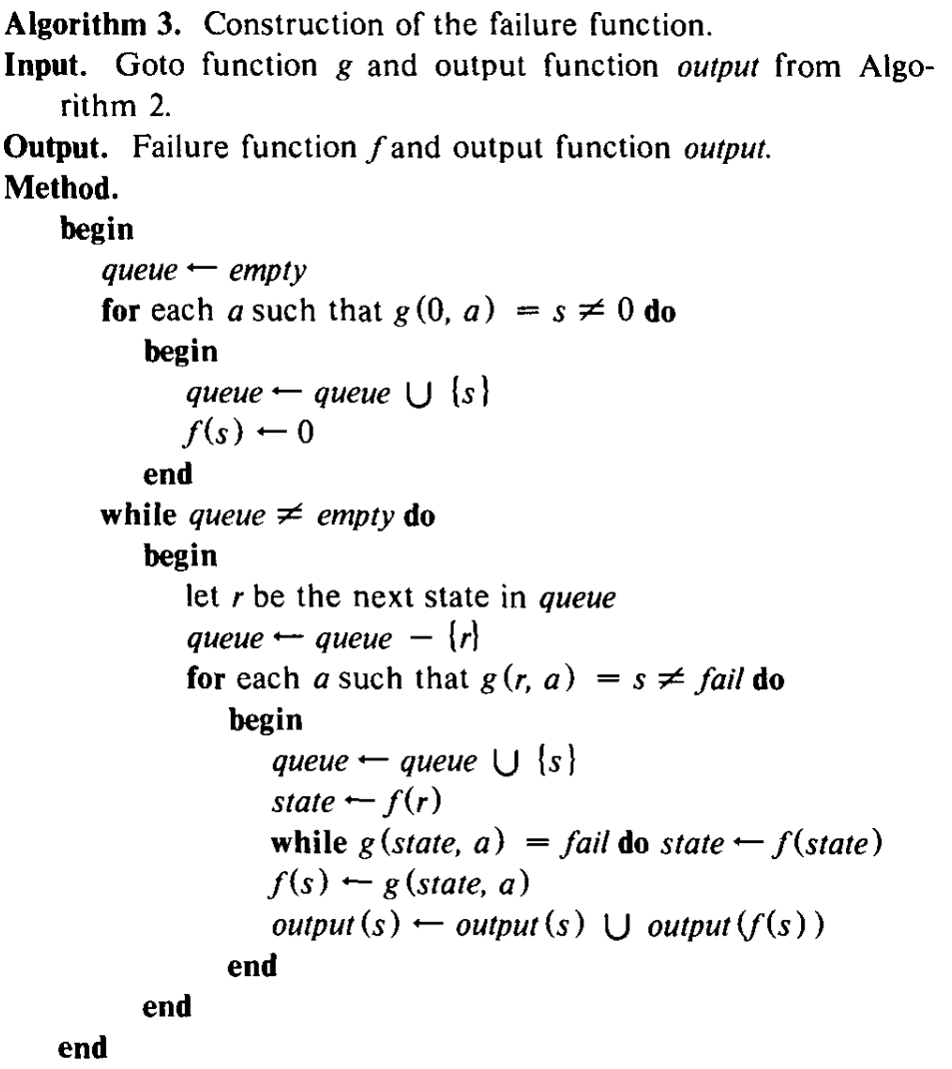
AC Algorithm: Calculate failure function
Multiple possible methods
An algorithm similar to BFS (Algorithm 3 in the paper)
Can also use next[] in KMP

Slide 40
More: Regex Matching
Regex = Regular Expression
More operations: [xyz], {n}, x|y, ., *
AC algorithm can be extended for Regex
DFA-based: awk, egrep, flex, lex, MySQL
NFA-based: GNU Emacs, Java, less, more, .NET, Perl, PHP, Python, Ruby, sed, vi
DFA and NFA are equivalent
DFA: scan every character once
NFA: each character can be accessed multiple times, but use less memory

